Slide 1

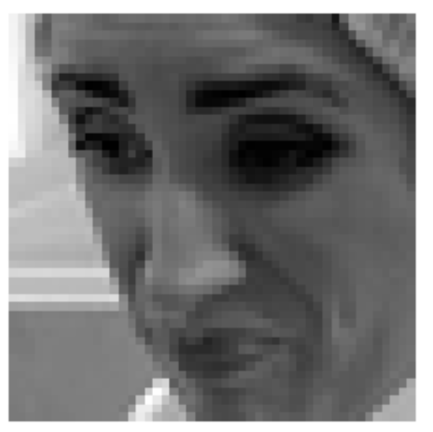
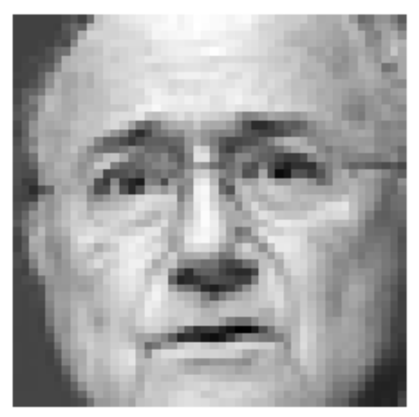
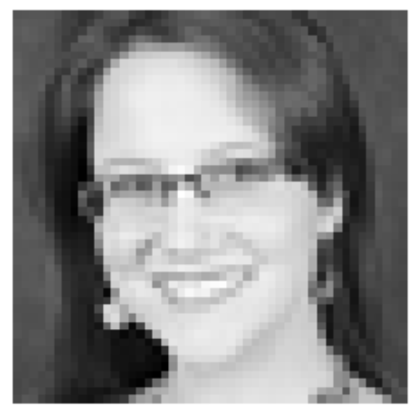
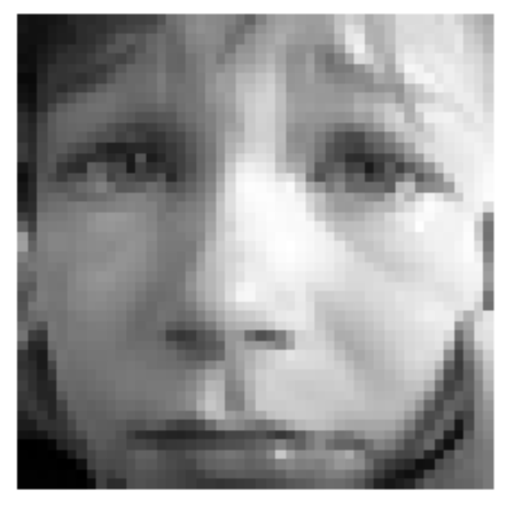

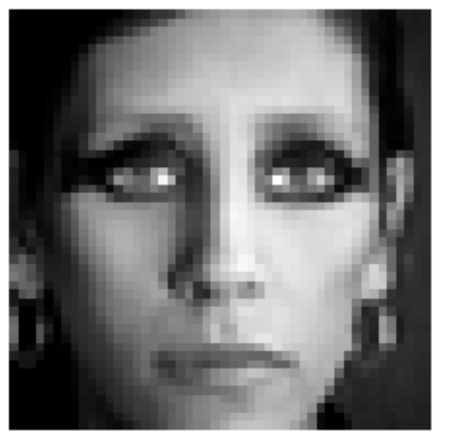
Facial IMAGE RECOGNITION
Classes: 0=Angry, 1=Disgust, 2=Fear, 3=Happy, 4=Sad, 5=Surprise, 6=Neutral
Team bengio:
Akshay Agarwal kannu priya arora vinod elangovan Gaurav FNU
Pankaj mittal claude phan Sandeep Kataria

Slide 2
Data source: https://www.kaggle.com/c/challenges-in-representation-learning-facial-expression-recognition-challenge/data
Training data size: 28709 samples (80% of complete set), each 2304 features long (48x48 grayscale image)
***elaborate count info
Class counts: [3995, 436, 4097, 7215, 4830, 3171, 4965]
Test set: 3589 samples (10% of complete set)
Methodology:
Linear Classification Analysis
Logistic Regression Analysis
Principal Component Analysis
Neural Networks

Slide 3
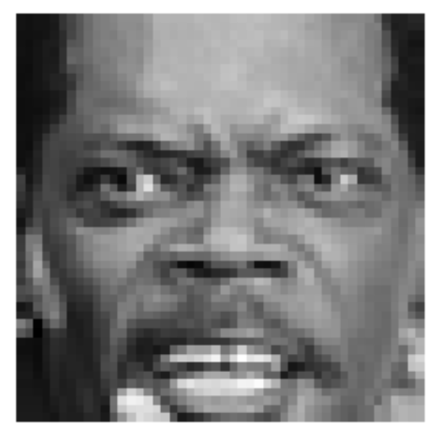
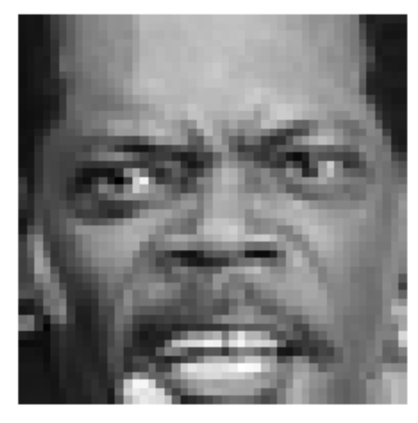
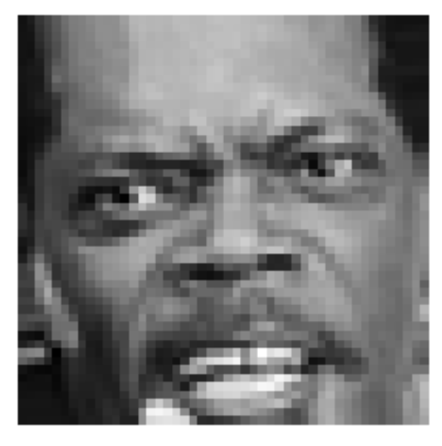
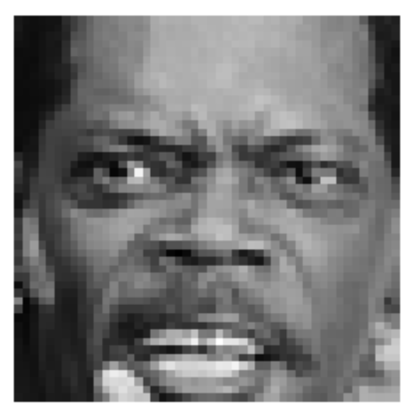
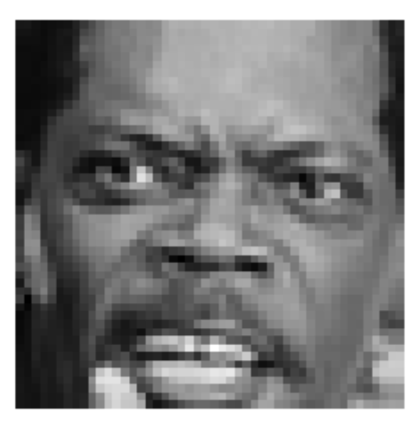
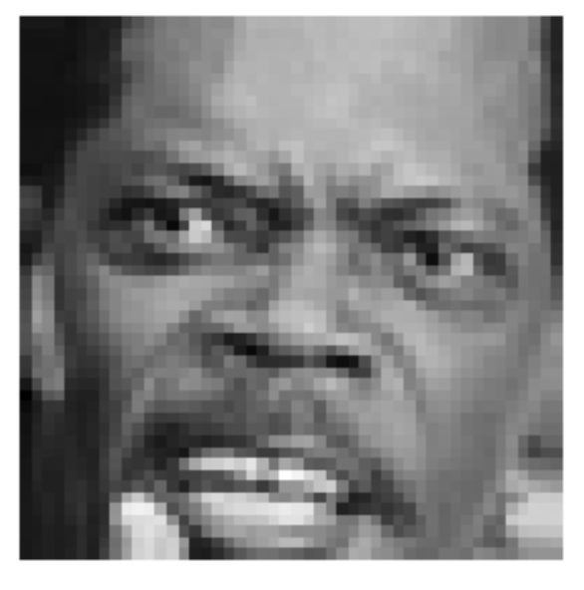

Data Augmentation: Data Size Increase using Image Rotation
3 degrees
6 degrees
10 degrees
Left
Right

Slide 4

Cluster Purity : soft or hard clusters
Purity is a measure of the extent to which clusters contain a single class. Its calculation can be thought of as follows: For each cluster, count the number of data points from the most common class in said cluster. Now take the sum over all clusters and divide by the total number of data points

Slide 5
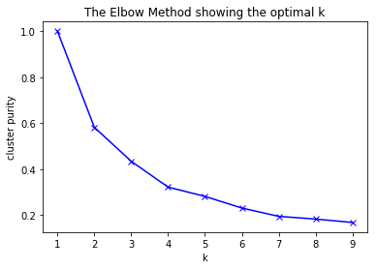
K-means (left) & Expectation Maximization

Slide 6

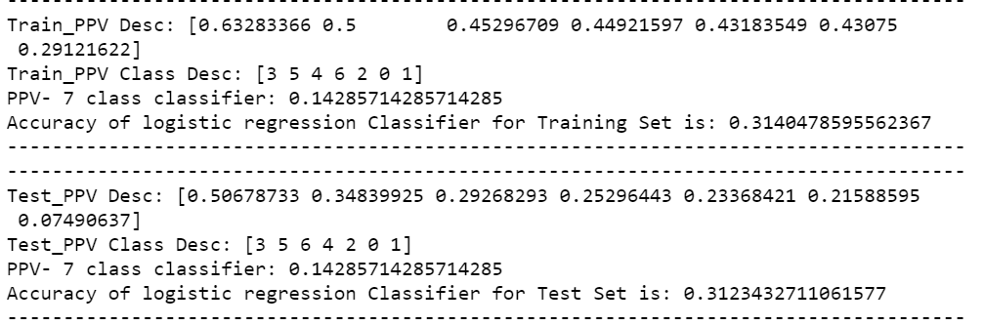
Logistic Regression classifier
Training set with 19 Principle Components explaining 75% of the variability, gave exactly the same results as the data with all the 2304 features.

Slide 7


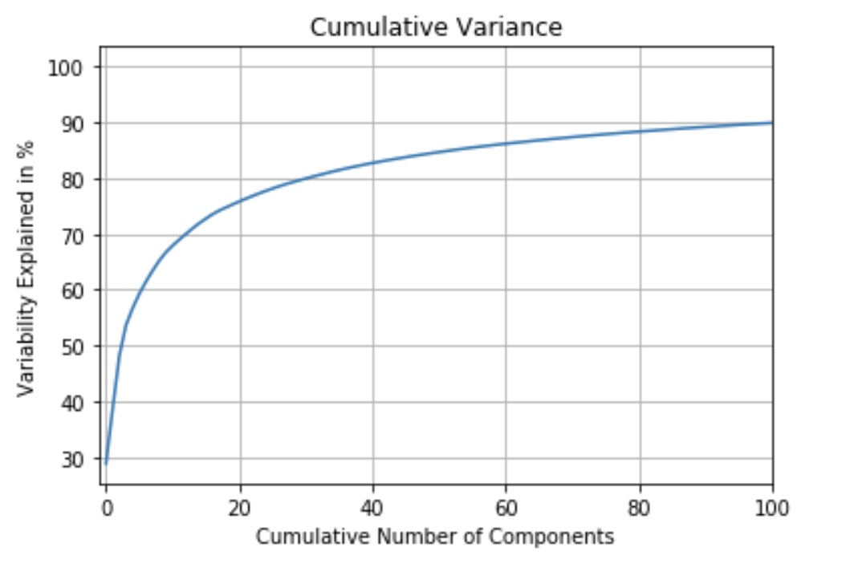
linear classifier
16% Accuracy on New Data
48% Accuracy on Test Data
34% Accuracy on Training Data
Attempted to use PCA with 350 components, yet accuracy was slightly worse.
Label = 1 (Disgust)
Predicted = 3 (Happy)
Label = 6 (Neutral)
Predicted = 6 (Neutral)

Slide 8
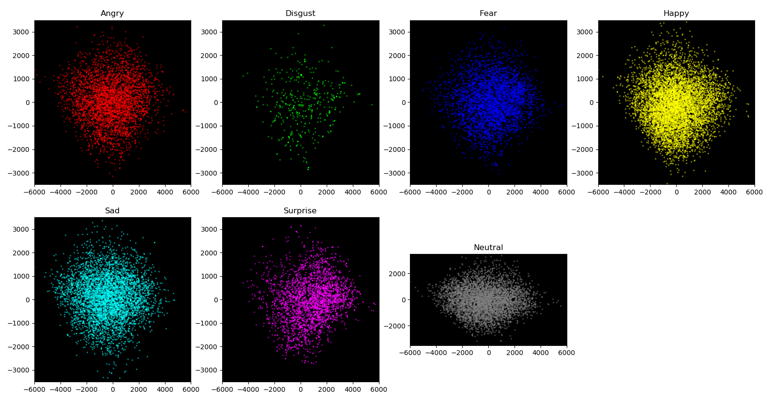
Bayesian Classifier
Scatter plot across the first two PCs, with each class shown in a separate plot
Trained on all 2304 original components, gave low accuracy of 18.86%
Performed PCA, and got better accuracy of 44.25% with first 360 PCs (more metrics shown in table below)
Tried couple of other approaches
augment the training set with 3 & 6 degree rotations,
balance the training set with random over-sampling
to get accuracy of 42.46% and 43.83%, respectively
 | ANGRY | DISGUST | FEAR | HAPPY | SAD | SURPRISE | NEUTRAL
PPV | 39.4% | 100% | 37.2% | 57.5% | 31.2% | 67.6% | 36.5%
Sensitivity | 22.2% | 29.1% | 27.7% | 60.9% | 40.9% | 54.1% | 50.2%

Slide 9
Neural Network

Slide 10
Model performance - Summary
 | Original components |  | With PCA |  | With Data Augmentation – Test Accuracy
 | Training Set Accuracy | Test Set Accuracy | Training Set Accuracy | Test Set Accuracy
Linear Classification Analysis | 48.30% | 34.88% | 39.41% | 18.02% | 32.21%
Bayesian Classifier | 50.73% | 18.86% | 76.61% | 44.25% | 41.38%
Logistic Regression Analysis
Neural Network

Slide 11
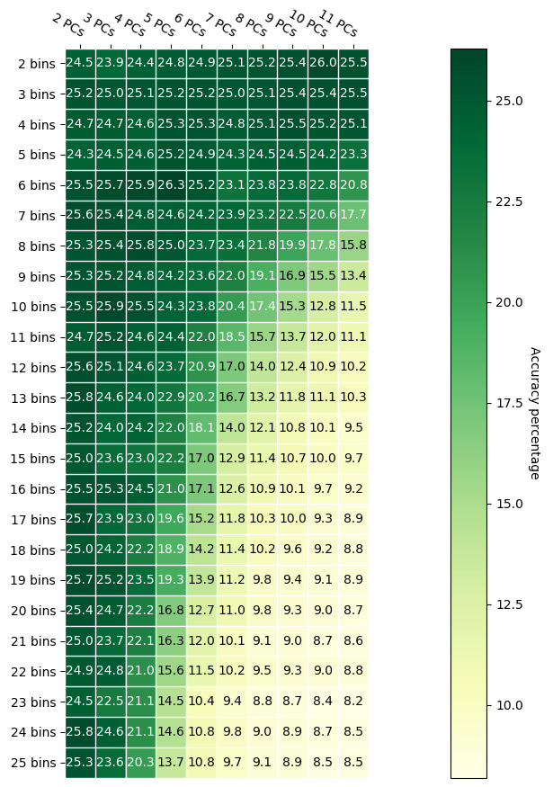
Interesting Observations
Why did Histogram classifier not work?
Say, we use 8 PC features, and 8 bins, we have ~17million bins in a histogram, but only 28709 data points. So, a very sparsely populated histogram.
When we look to predict with such a histogram, bins corresponding to queries are likely empty, resulting in no prediction.
Table shown to the right indicates this condition.

Slide 12
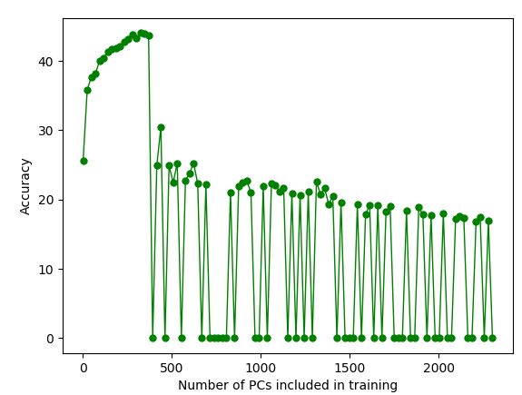
Interesting Observations
Bayesian classifier accuracy falls after a certain number of Principal Components
PCA gave us 2304 PCs. And initially, for the first ~360 components, adding them to training set improved the accuracy. But beyond that, accuracy started to decline.
Beyond 370 PCs, the covariance matrices get quite large, and unstable. Many cases, the determinant evaluates to a negative value, preventing predictions as well.
NOTE: even for lesser number of PCs, switched to ‘numpy.linalg.slogdet()’ and determined ‘pdf’ on a log scale, as ‘numpy.linalg.det()’ fails with “RuntimeWarning: overflow encountered”.

